Slide 1
Year 4
Curriculum Evening 2025
St. Nicholas Class
Miss Buchanan

Slide 2
We start every year reminding ourselves of the school’s Golden Rules as these underpin everything we do whilst in school.
Golden Rules
Follow instructions. Listen to all adults working in the school.
Be gentle, kind and polite: keep hands, feet and unkind words to yourself.
Value people’s belongings; respect the school and other people’s property.
4. Be honest and tell the truth.

Slide 3
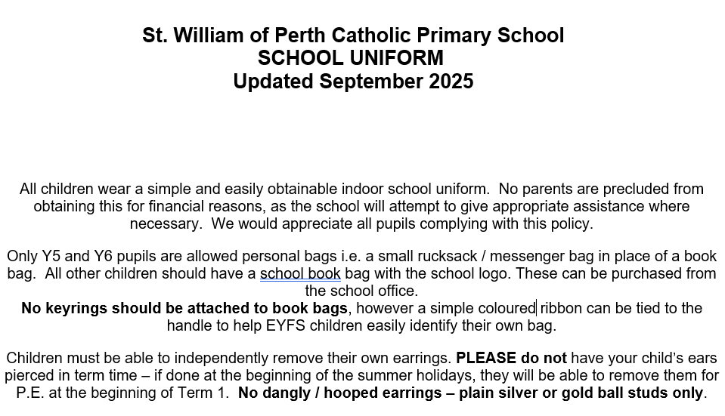

Slide 4
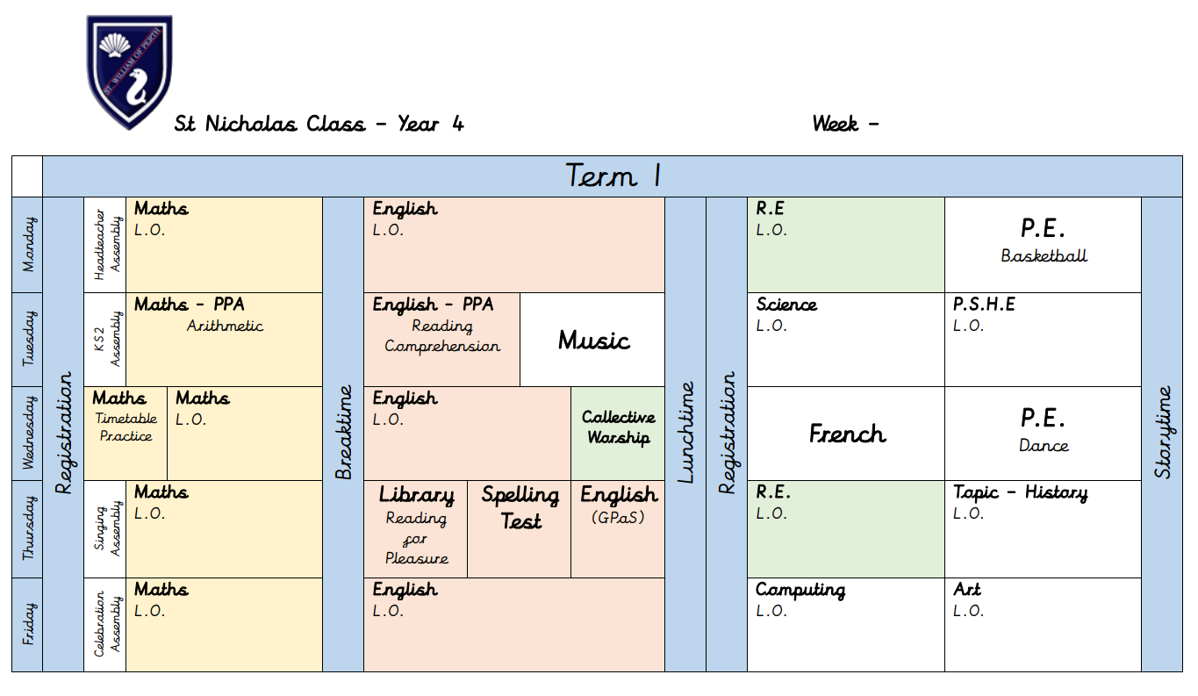
Term 1 Timetable:

Slide 5
Topic Overview:
Term 1 – The Romans
Term 2 – South America
Term 3 – North America
Term 4 – Ancient Egyptians
Term 5 – Ancient Egyptians
Term 6 – Maya Civilisation

Slide 6
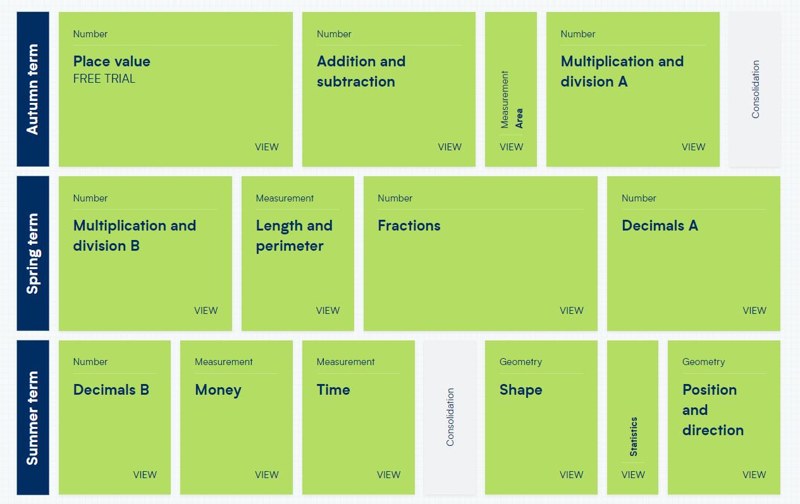
Mathematics Yearly Overview:

Slide 7
Year 4 Timetables Check:
The Multiplication Tables Check is a key stage 2 assessment to be taken by pupils at the end of Year 4 (in June).
The purpose is to ensure that the times tables knowledge is at the expected level.
The multiplication tables check is statutory for primary schools.
The Multiplication Times Tables Check is an online test where the pupils are asked 25 questions on times tables 2 to 12.
For every question, you have 6 seconds to answer, and in between the questions, there is a 3-second rest.
Questions about the 6, 7, 8, 9, and 12 times table come up more often. The questions are generated randomly.

Slide 8
Year 4 Timetables Check:
In class we have:
Dedicated daily timetables practice.
Weekly timetables test.
Use of TimeTables Rockstar's. (Log in details are in the back of reading records)

Slide 9
Writing:
Handwriting
Spelling
Grammar
Structure
Punctuation
Expansive Vocabulary
Writing for purpose / tone
How this is achieved:
Reading!
Analysing quality texts
Modelled writing
Shared writing
Independent writing (including proof-reading/ editing)
Spelling lessons
Grammar and punctuation lessons

Slide 10
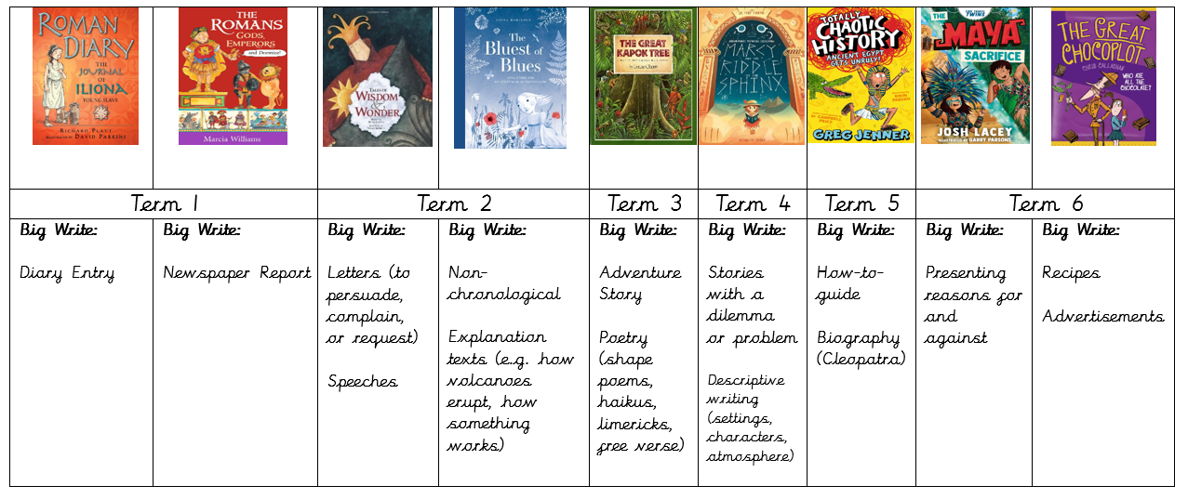
Writing:

Slide 11

Reading:

Slide 12
P.E:
Monday
Outdoor P.E
Wednesday
Indoor P.E
School P.E Kit:
Plimsoles (trainers for cold/wet weather).
Navy shorts.
School t-shirt.
Socks (no tights).
Navy blue or black tracksuit.
NO jewellery please.
Current guidance states that P.E. lessons should take place outside as far as it is possible to do so. Please ensure that your child has the appropriate kit for P.E. outdoors.

Slide 13
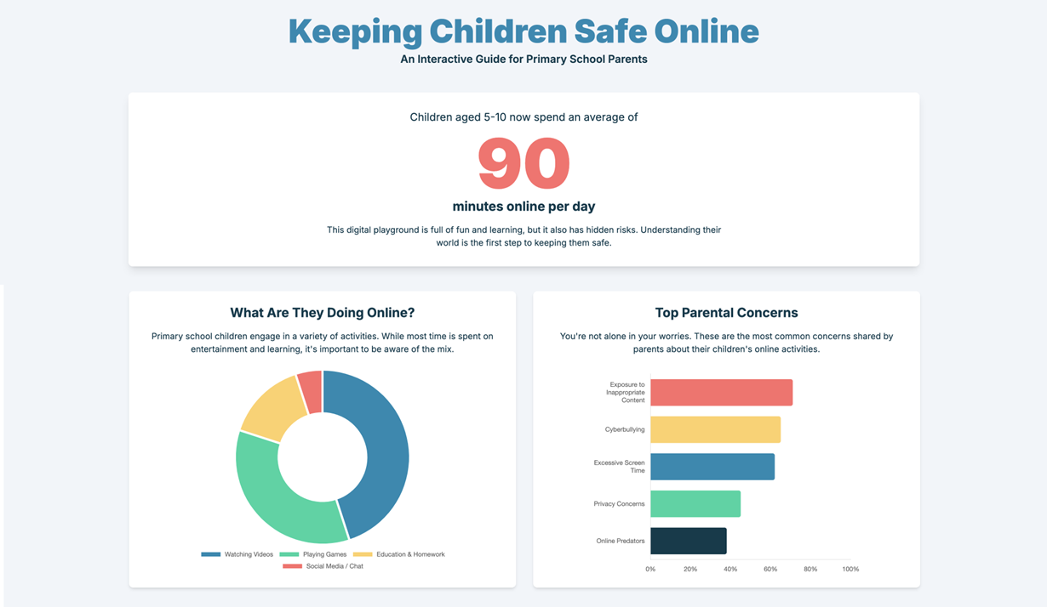

Slide 14
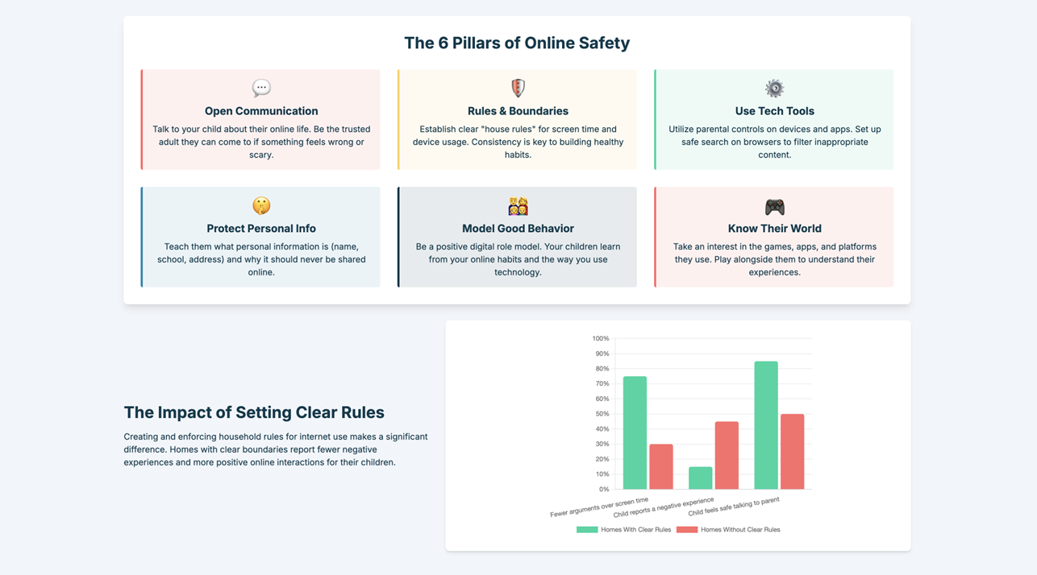

Slide 15
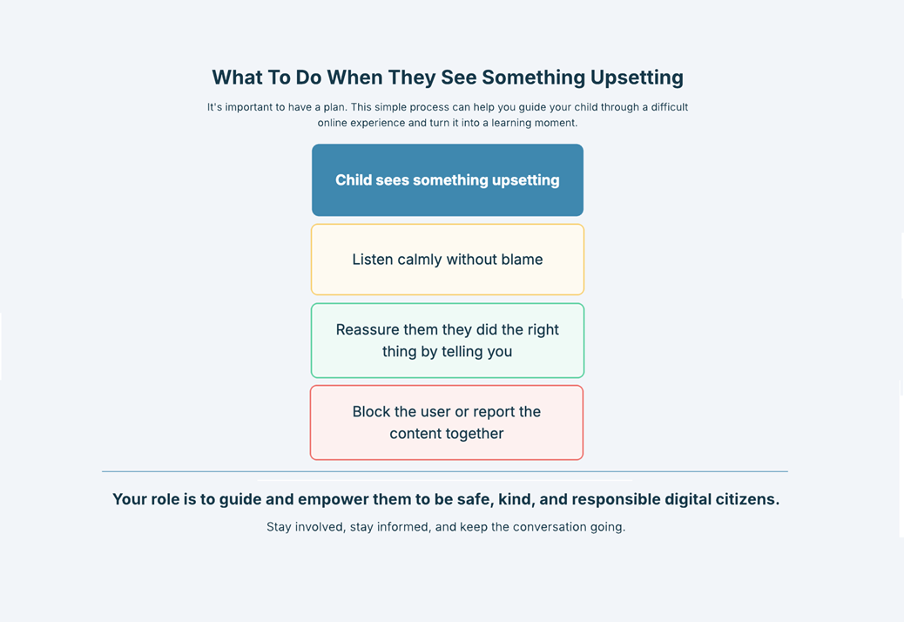

Slide 16
Homework:
Set every Friday and due to be completed by the following Thursday.
Spellings:
- Set on EdShed and sent home on paper.
Maths:
- TimeTables Rockstar’s. (Sound Check & Studio)
Home Reading:
10 / 20 minuets of reading everyday, and to be logged in their reading records. This is checked by us every morning.

Slide 17
Communication:
Always happy to discuss any issues that may arise.
You can send a message using Class Dojo (8:15am – 4:30pm)
You can contact the office to arrange a meeting.

